Slide 1
Investor Presentation
Interim Results for Period H1 2011
Presentation August 2011
Mr Weijun Yu
Mr Shiang-Peow Foo
Mr Richard Bennett

Slide 2
China New Energy Limited (AIM:CNEL)
China New Energy Limited is a technology, process and engineering solutions provider, whose operations are based in China, for bioethanol and biobutanol projects focussing on the bioenergy sector:
Results Summary
Revenue up 54.7% to RMB 49.2m
(H1 2010: RMB 31.8m)
Gross Profit up 60.9% to RMB 6.97m
(H1 2010:RMB 4.33m)
Gross Margin improved to 14.1%
(H1 2010:13.6%)
Net Profit of RMB 0.8m
(H1 2010: [RMB –1.0m] )
Period Highlights
Admission to AIM
Secured RMB 168m of new contracts in H1 (up 194% from RMB 57m in H1 2010)
Major win: 400,000 litre/d edible ethanol and fuel ethanol plant for Ubon Bio-ethanol Company in Thailand
Outlook
Strong order book and sales pipeline
Biobutonal trial from cellulosic feedstock
Established track record in China, SE Asia and Europe
Advised on 88 projects with total contract value of RMB 1.5bn
Aggregate client production capacity of 9.0m tonnes
Internal R&D, patented technology and manufacturing
Experienced leadership team
Growing worldwide market for bioenergy
Strong pipeline of bioenergy projects

Slide 3
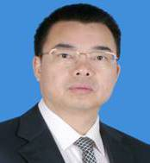
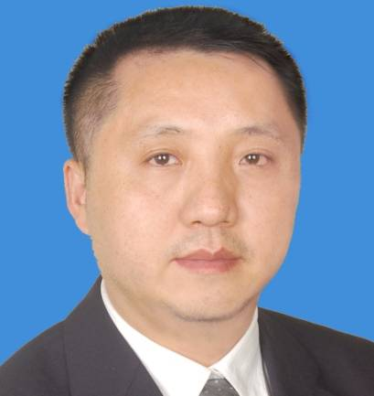
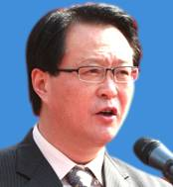
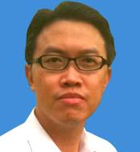
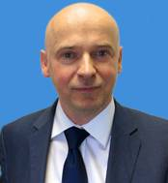
Board of Directors
YU Weijun (46) MBA, Executive Chairman
Mr. Yu is the Chairman of CNE and ZKTY and is primarily in charge of the overall strategic planning and corporate development of CNE. Prior to joining CNE, he worked was Deputy Chief of GIEC CAS. Mr. Yu holds an Executive Master of Business Administration from Sun Yat-sen University and is a member of the Chinese Institute of Certified Public Accountants.
TANG Zhaoxing (41), BSc, MBA – Chief Executive Officer
Mr Tang is the managing director of ZKTY. He is responsible for the overall company operation, sales and project design and management. Prior to joining ZKTY, he was managing director of GZTY Regeneration Resources , of which he is still a director. Mr. Tang graduated from South China Science & Tech University with a degree in Chemical Engineering, and holds an EMBA from Peking University.
Chen Yong (53) BSc, MSc, Ph.D. – Non-executive Director (independent)
Mr. Chen is the President of Guangzhou Branch, Chinese Academy of Sciences. His major is researching in utilization of municipal solid wastes and management. He was a director of GIEC CAS from April 1998 to October 2006 and has been a Professor since October 1996.
FOO Shiang-Peow (40) MBA - Non-executive Director (not independent)
Mr. Foo has many years’ investment and corporate finance experience. He is currently a director of NovusAsia Capital Limited. Mr. Foo started his career as an equity analyst in Salomon Brothers Inc, based in Singapore, in 1994 and subsequently moved to Credit Suisse First Boston.
Richard BENNETT (43) - Non-executive Director (independent)
Mr. Bennett started is career working for General Electric (GE) in Asia. He was a co-founder of J2 Inc. (NASDAQ:JCOM), and developed two businesses which have been admitted to the AIM market, VI plc and Coms plc (AIM:COMS). He is currently also a director of Jade Clean Technology Limited.

Slide 4
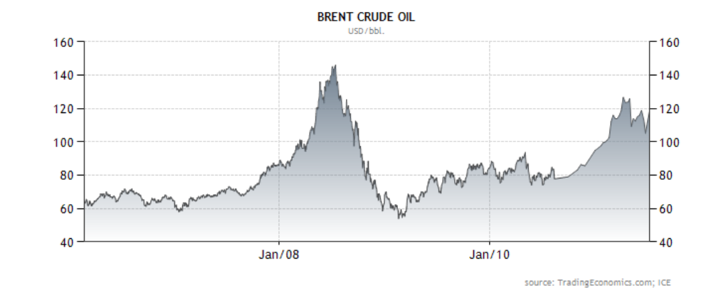
Climate Change Goals & Energy Security Drive the Bioenergy Market
Climate Change Targets
  Both Bioethanol and Biobutanol are carbon neutral fuels that reduce emissions of
  carbon dioxide (CO₂)
  Contributes to national sustainability goals
Energy Security
  Growing domestic fuel crops for transportation fuels for oil-poor countries
  Decrease reliance on oil imports and and difficult countries and oil price shocks
Oil Price
  Peak oil concerns as demand increases (especially in Asia)
  Long term oil price trend forecast to remain high
CNE technology typically economic at equivalent to
$80 per barrel of oil
CNE researching technology that will be economic at
equivalent to $60 per barrel of oil

Slide 5
Global Growth Forecast for Bioenergy Projects
Chinese Domestic Market Demand
Global Market Demand
China is a net importer of oil, and the second largest consumer of oil after the US:
  Domestic power consumption forecast to grow to 20% p.a
  New car sales overtaken US, and car ownership expected to double by 2020
NDRC forecasts bioethanol production will will increase to 10m tons in 2020
Novozymes and Mckinsey predict that cellulosic bioethanol could be substituted for 31m tons of gasoline in China by 2020, cutting the nation's oil imports by 10%
Biofuel blending targets being implemented globally (10% of road fuels in the EU by 2020)
Biobutanol may become the aviation fuel of the future (Virgin Atlantic expect commercialisation as early as 2015
Bioenergy is widely considered to be one of the key alternatives to fossil fuel use because of its easy acquisition and clean emissions.

Slide 6
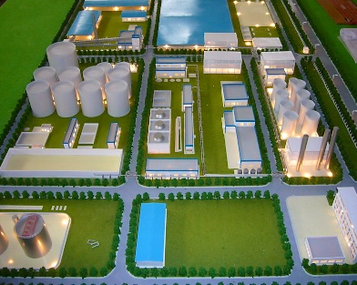
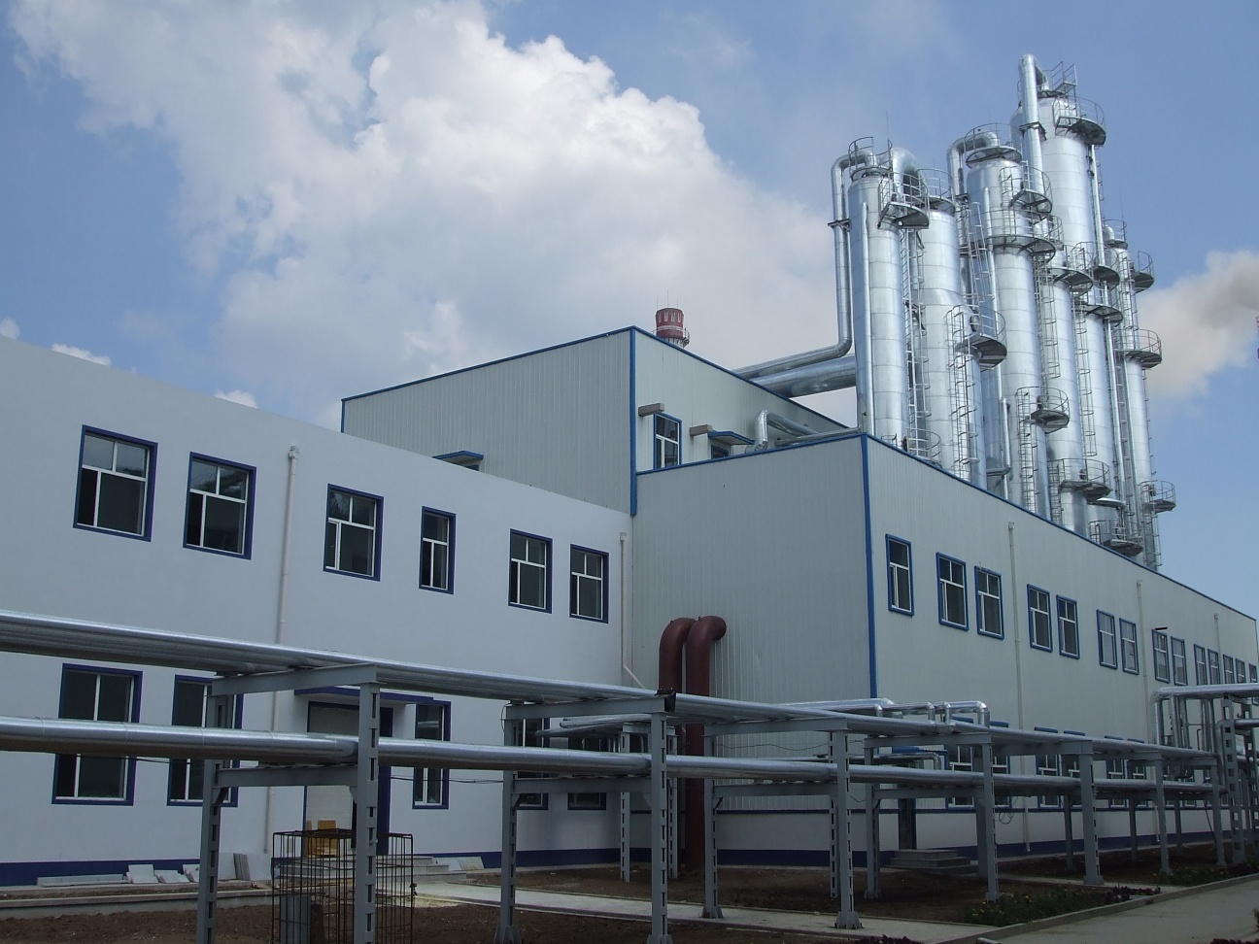
Bioenergy Technology Provider
Commercialising Patented Technology
  In collaborations with China Academy of Sciences (“CAS”) / Guangdong Institute of Energy Conversion (“GIEC”)
  12 patents owned and being commercialised by CNE
Key Processes
  Fermentation of feedstock into alcohol
  Distillation of alcohol into ethanol
  Dehydration of ethanol to produce pure fuel grade products
  Energy efficiency and recycling of waste biogases
Primary Feed Stocks
  Starch (cassava, corn)
  Sugar
  Cellullosic waste and other non-foods ^{*2011/12}
Products
  Fuel grade bioethanol and biobutanol ^{*2011/12}
  Edible Alcohols
  Alcohols for medicine and cosmetics

Slide 7
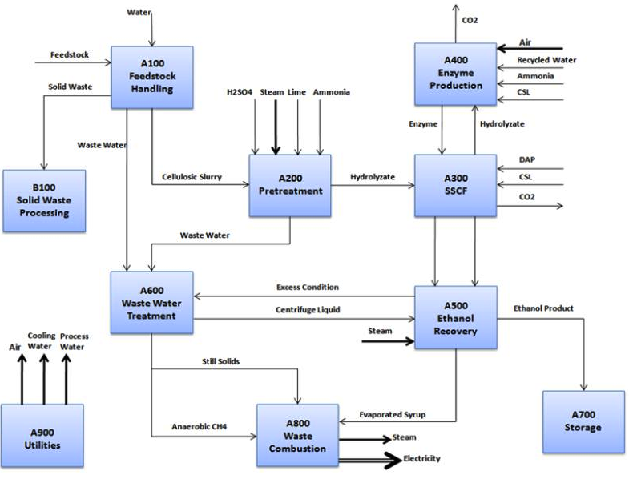
Biorefinery Process

Slide 8
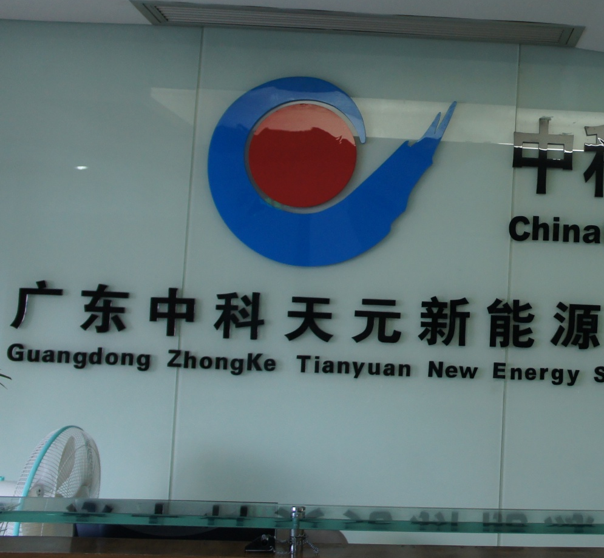
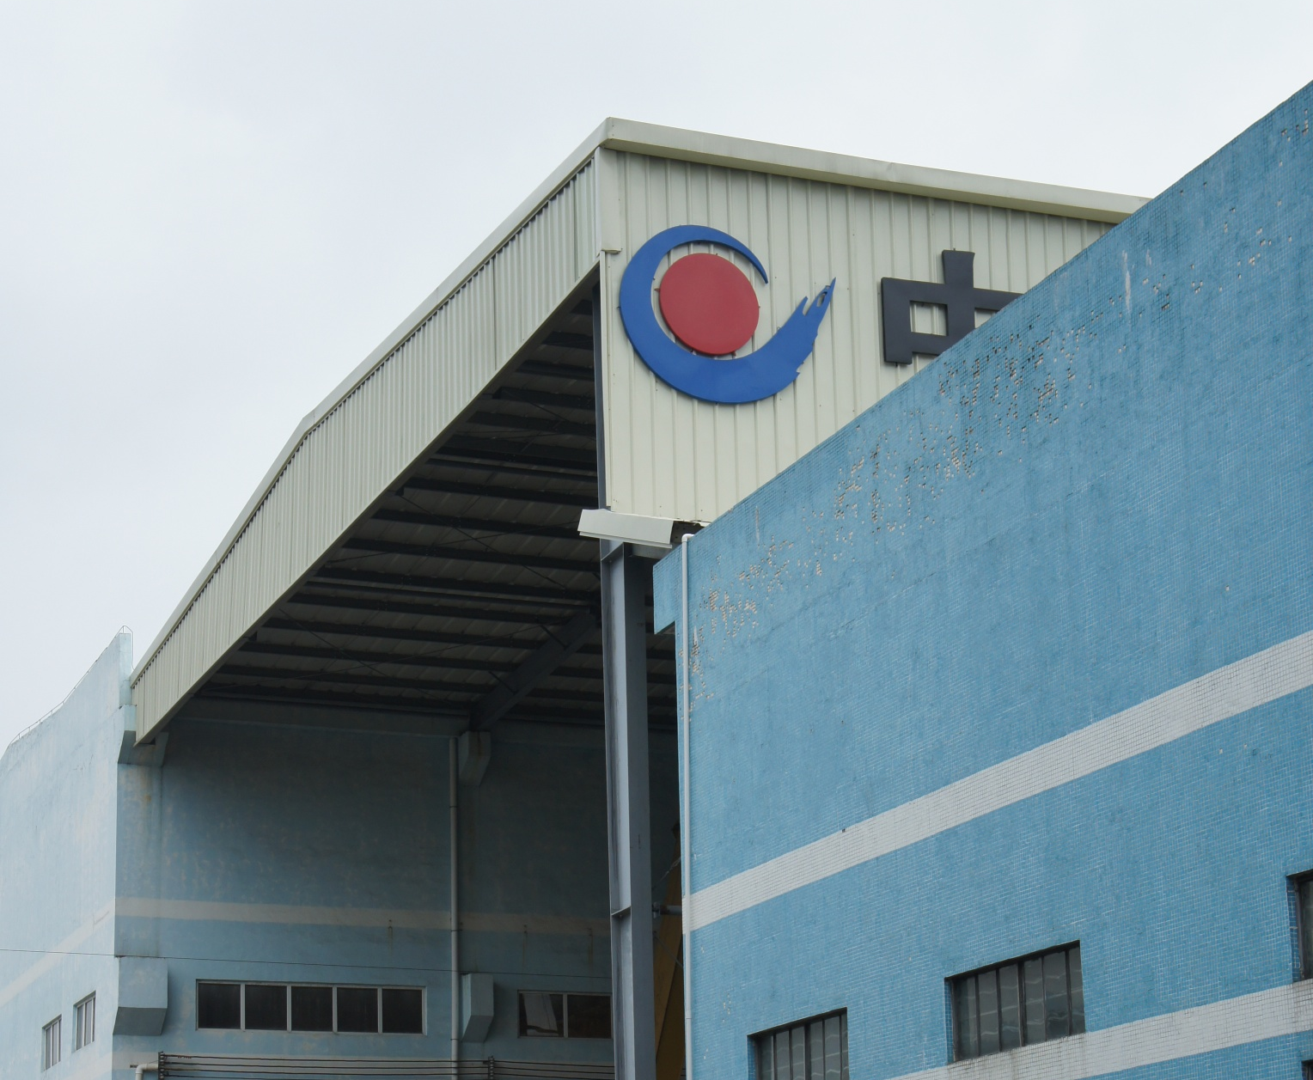
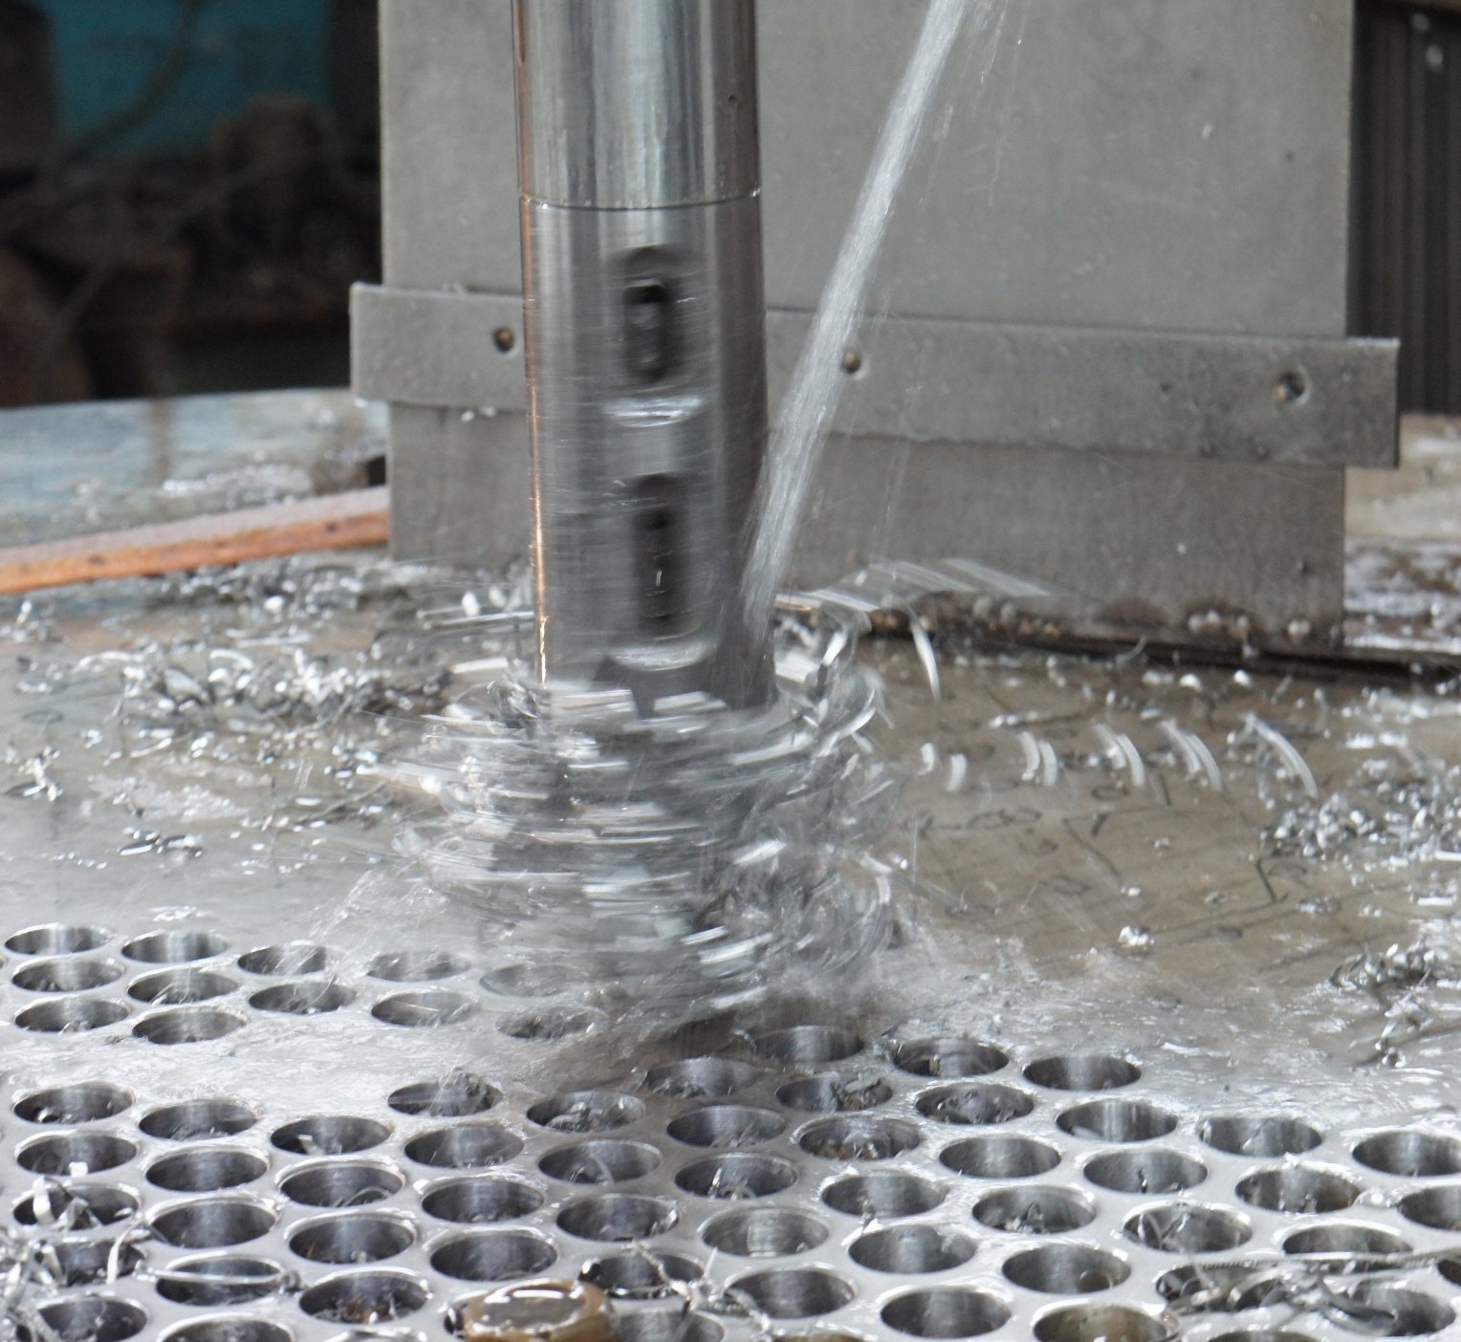
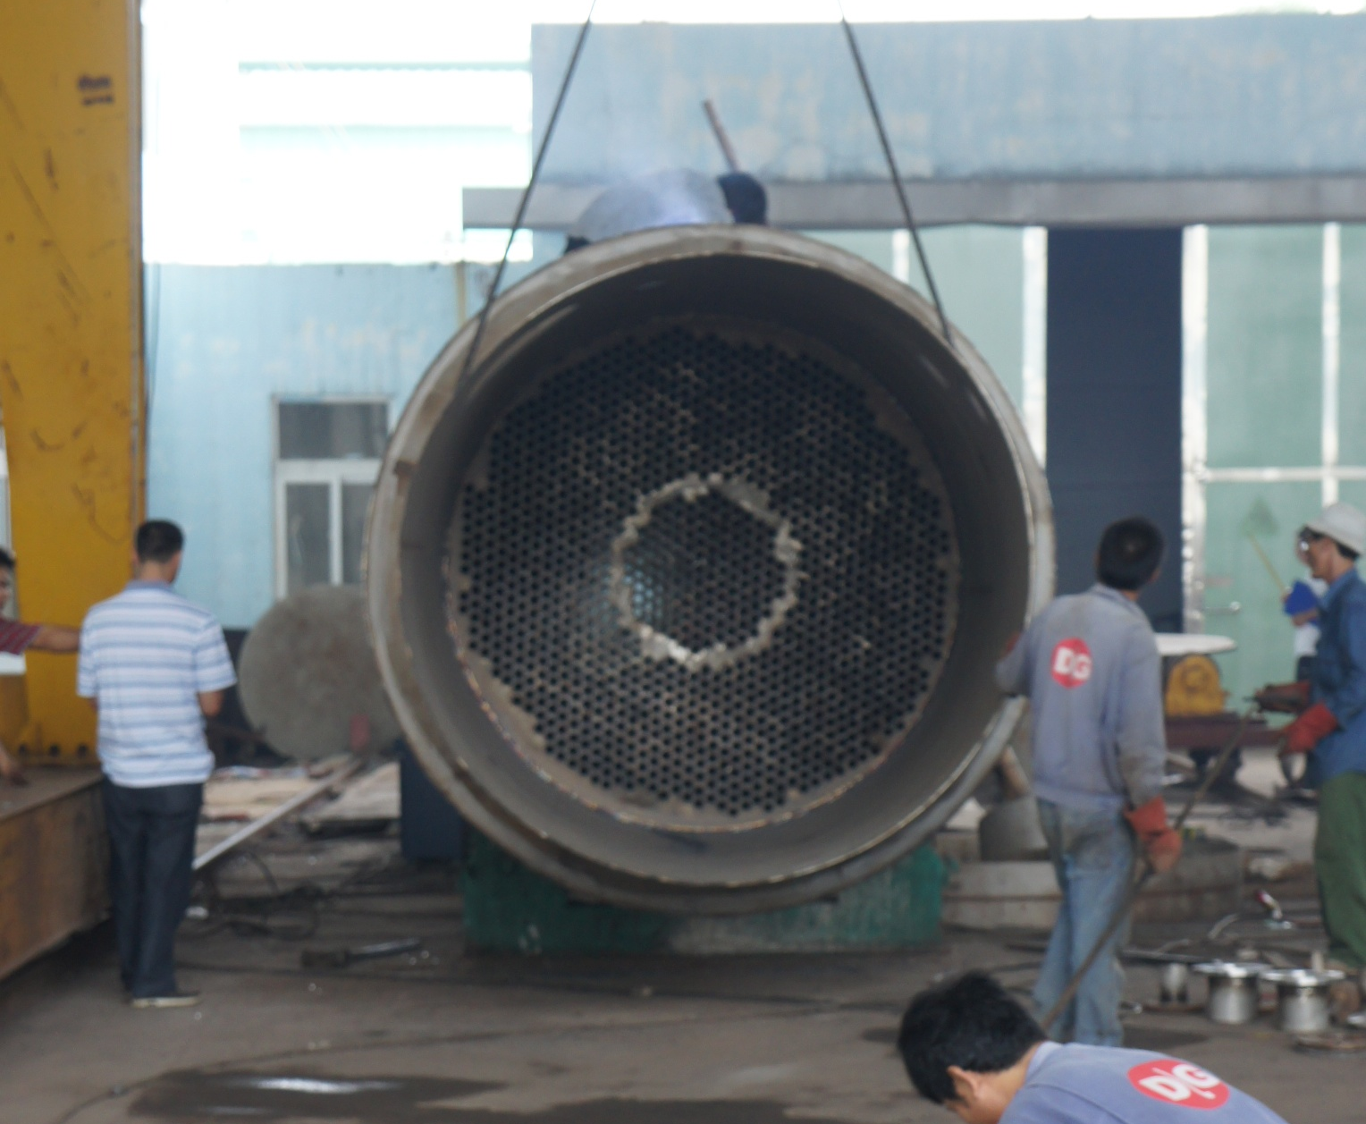
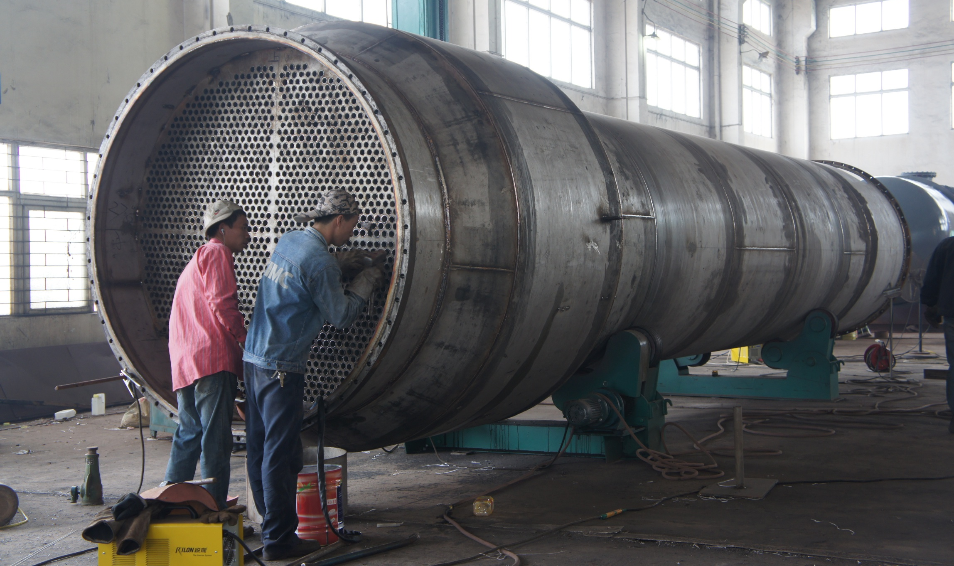
Construction, Procurement and Engineering (CPE) Solutions
Full Solution Provider
Head office, Guangzhou
  Business development team
  Plant design
  Project Management
Manufacturing plant, Guangdong
  Procurement
  Fabrication
On site
  Construction
  Training
  Maintenance
CNE is complete bioenergy solutions provider

Slide 9
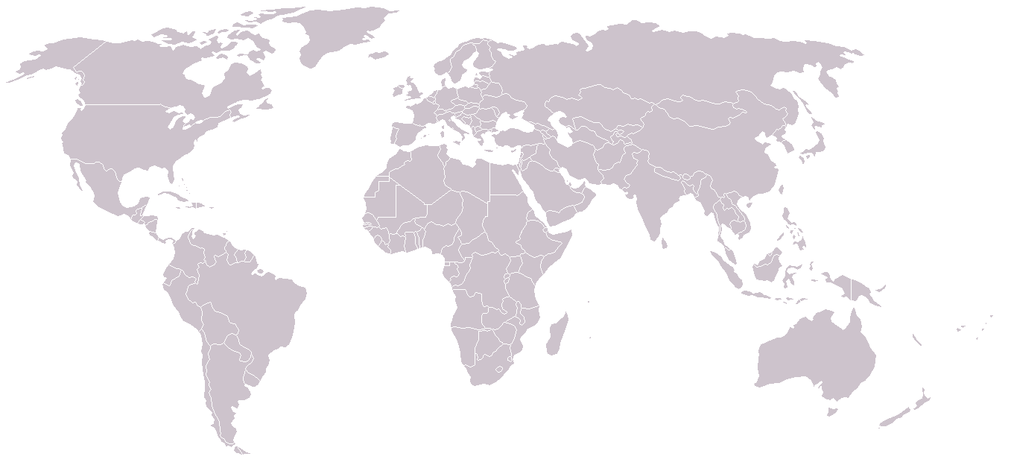

88 Projects World Wide
Europe and Russia
Projects completed and under construction in Russia and Eastern Europe. Seekiing European projects and M&A opportunities-
Europe and Russia
Projects completed and under construction in Russia and Eastern Europe. Seekiing European projects and M&A opportunities-
Europe and Russia
Projects completed and under construction in Russia and Eastern Europe. Seekiing European projects and M&A opportunities-
China and Central Asia
>60% Market Share in China
Bioethanol Refineries
Biobutanol demonstration plant
China and Central Asia
>60% Market Share in China
Bioethanol Refineries
Biobutanol demonstration plant
North America
R&D Partnerships and pilot piobutanol project. Seeking commercial scale biobutanol projects and M&A opportunities.
North America
R&D Partnerships and pilot piobutanol project. Seeking commercial scale biobutanol projects and M&A opportunities.
North America
R&D Partnerships and pilot piobutanol project. Seeking commercial scale biobutanol projects and M&A opportunities.
South East Asia
Large projects completed and under construction. Pitching for new projects in Vietnam, Thailand and Indonesia
Projects under Construction

Slide 10
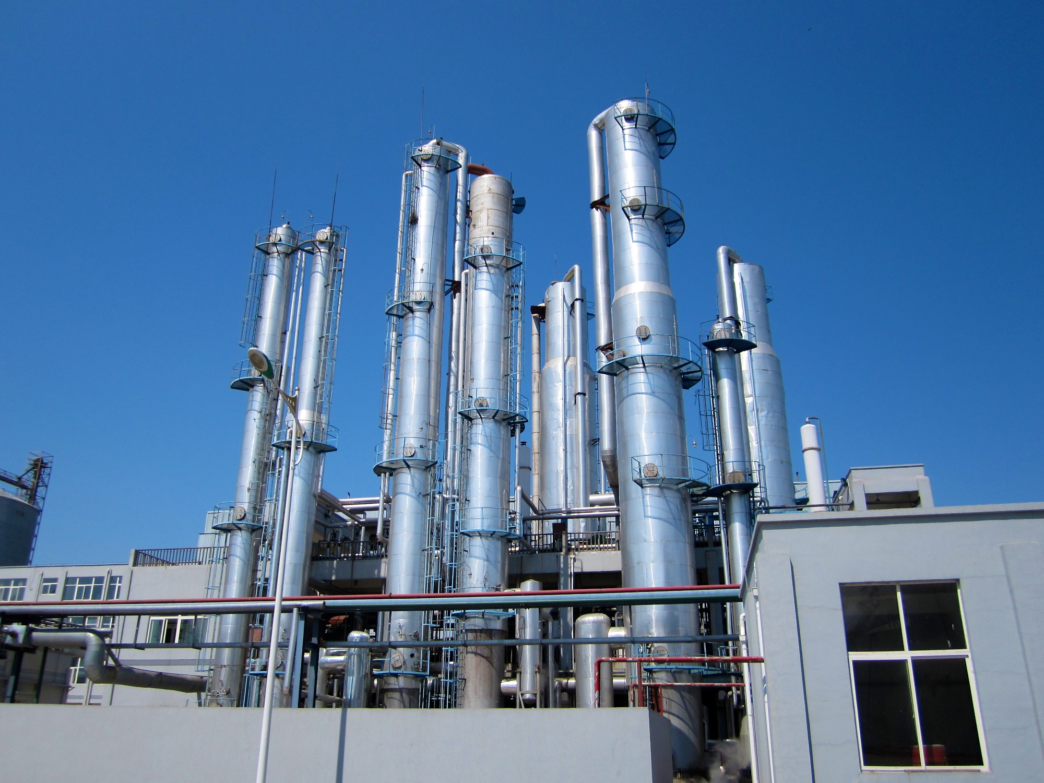
Example Project
Project:
Songyuan Ji'an
Country:
China
Capacity:
150,000 bio-butanol
Date Built:
2007
Feed Stock:
Corn

Slide 11
Technology Road Map
Generation 1.0
Bio - Refinary
Generation 1.1
Enhanced
Bioethanol Refinery
Generation 2.0
Biobutanol
Refinery
Next Gen
Algae???
Original bioethanol refineries that convert sugar and starch feedstocks into bioethanol and bioethanol
Energy Management and Conservation (EMC) upgrades that decrease the operating costs of a biorefinery
New refineries (or retrofitted refineries that can process cellulosic (non-food) feedstocks into biobutanol
R&D projects suggest future biofuels may be produced from Algae
The majority of projects completed by CNE to date are biothanol refineries
CNE constructed one of the largest biobutanol plant in the world (150,000 tpy)
Majority of CNE’s clients and other biorefineries benefit from these upgrades that include enhanced steam management and processing waste water
CNE is developing the first production biobutanol refinery in China that utilises cellulosic feedstocks
This is expected to be a significant growth market for the company

Slide 12
Business Model
Bioenergy Refineries (CPE)
  Low working capital
Energy Management and Conservation (EMC)
  Deploy EMC equipment and IP to improve biorefinery efficiency
  Share of cost savings (~50%)
  Incremental revenues for modest working capital requirement
Refinery Operations and Ownership
  Under investigation for 2012
  Acquire sub-optimal biorefineries that can be converted to biobutanol (leverage our in-house expertise)
  Recurring revenues, but requires capital investment

Slide 13
Consolidated Statement of Financial Position

Slide 14
Consolidated Profit and Loss Statement
14

Slide 15
Consolidated Statement of Cash Flow

Slide 16
Corporate Structure and Share Structure
Company Structure
Share Holdings
China New Energy Limited
(CNEL)
Jersey Incorporated and AIM quoted holding company
Overseas
China
100%
Guangdong Zhongke Tianyuan New Energy Science and Technology Co. Ltd (ZKTY)
Wholly foreign owned enterprise and trading entity
100%
Advisors
Guangdong Boluo Jiuneng High New Technology Engineering Co Ltd. (Boluo)
Technology and Engineering Company
Nomad Cairn
Broker SVS
Lawyers Stephenson and Harwood
Auditor Crowe Clark Whitehill
Registrar Computershare

Slide 17
Outlook
Business Goals
Corporate Development Goals
Fulfil current order book
Maintain pipeline of Generation 1 project opportunities
  Biorefineries
  EMC opportunities
Launch Generation 2
  Complete biobutanol trial from cellulosic materials (China)
  Complete waste biogases R&D projects in China (in partnership with CAS)
Raise IR and Business Profile
Developing institutional shareholder base
M&A activities to:
  Increase skills and technology portfolio
  Expand geographic footprint (S.E Asia, U.S., EU and Europe)
  Acquire suboptimal biorefineries that can be converted to biobutanol

Slide 18
Summary
Growing demand for bio-refineries
  Macro trends of energy security and climate change are driving global demand
  Domestic governments implementing biofuel initiatives and mandates
CNE is an established and well run company
  Own IP and low-cost operating and manufacturing
  Profitable from core activities of building biorefineries
  Strong order book and pipeline of new projects
  Implementing new recurring revenue streams from EMC activities
  Leading the way to generation 2 or cellulosic (non-food crop) biorefineries
Ambition to expand internationally
  Listed on AIM to increase profile and access capital
  Investigating numerous acquisition targets to increase geographic footprint and expertise
  Become a market leader in Generation 2 biofuels from cellulosic feedstocks
  Building a profitable international company

Slide 19

Contact Information
China New Energy Limited
Queensway House
Hilgrove Street
St Helier
Jersey
JE1 1ES
Channel Islands
Web www.ChinaNewEnergy.co.uk
EPIC CNEL
ISIN JE00B3RWLF12
ZKTY
8F Technology Integration Building of GIEC
4 Nengyuan Road
Wushan
Tianhe District
Guangzhou
China
Web www.zkty.com.cn
Mr Weijun YU (Chairman)
wyu@zkty.com.cn
 +44 (0)7966 388 374
Mr Zhaoxing TANG (CEO)
ztang@zkty.com.cn
 +44 (0)7966 388 374
Mr Shiang-Peow FOO (NED)
sfoo@zkty.com.cn
 +65 9623 8948
Mr Richard BENNETT (NED)
rbennett@zkty.com.cn
+44 (0)7966 388 374

